Slide 1




ADVANCED NATIVE MOBILE PROGRAMMING (1604C062)
Navigation part 2
WEEK 02 Informatics Engineering
Universitas Surabaya
Informatics Engineering | Universitas Surabaya
Notes:
Cover Dark
Gambar vector bisa didownload di: https://scale.flexiple.com/illustrations/
Jika ingin foto free royalty bisa download di: https://pixabay.com/photos/

Slide 2
Outline
1
2
3
4
PopUpTo
Bottom Bar Navigation
Dialog
Drawer
Informatics Engineering | Universitas Surabaya

Slide 3
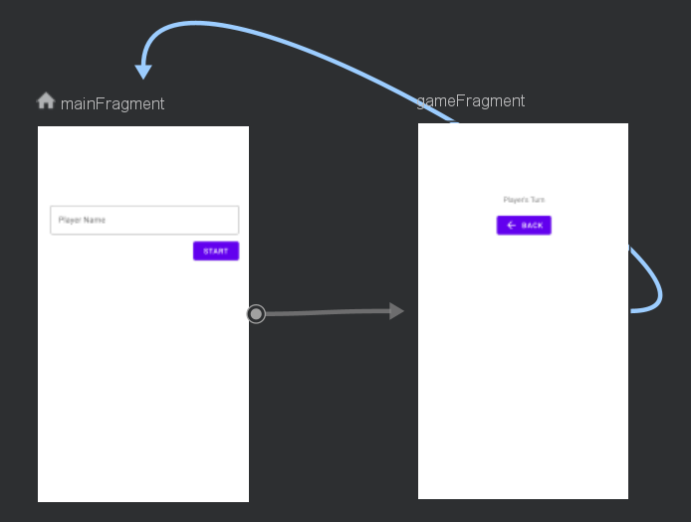
Popup
Lets start with an example
Two fragments. Main can navigate to game fragment, vice versa.
Photo here
Informatics Engineering | Universitas Surabaya

Slide 4
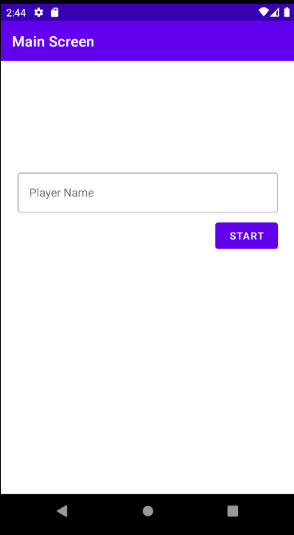
MainFragment serves as the “default” or “main” fragment
MainFragment
The initial backstack only have one fragment (main)
BackStack
Informatics Engineering | Universitas Surabaya

Slide 5
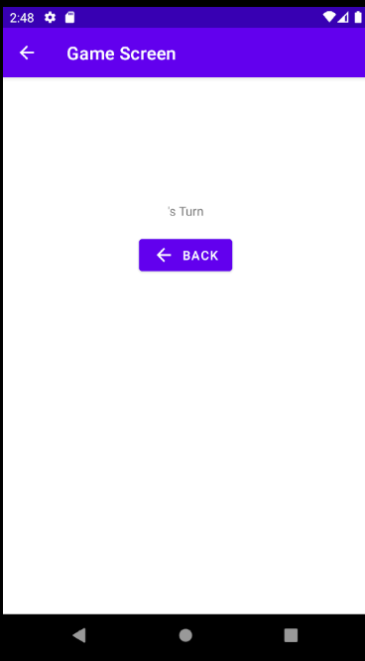

Player then presses start button (navigate to game fragment)
Game Fragment
Now backstack contain two fragments. What happen if back button is pressed?
MainFragment
BackStack
Informatics Engineering | Universitas Surabaya

Slide 6

Player then presses back
The default behavior is that a new instance of the Destinations Fragment is created. Now, the backstack contains three fragments, with two instances of MainFragment.
MainFragment
Game Fragment
MainFragment
BackStack
Informatics Engineering | Universitas Surabaya

Slide 7
And then player presses start button (navigate to game fragment)
Game Fragment
MainFragment
Another instance of GameFragment created on backstack. How to change this behavior?
Game Fragment
MainFragment
BackStack
Informatics Engineering | Universitas Surabaya

Slide 8
Using PopUpTo
popUpTo attributes can be applied to an action (arrow) to remove backstack content until it reaches the destination fragment
example:
Let's say there are currently three fragments in the backstack. From Fragment C, you can navigate to Fragment A.
Fragment C
Fragment B
Fragment A
Informatics Engineering | Universitas Surabaya

Slide 9
Using PopUpTo
Using popUpTo fragmentA, it will popup every item on backstack until it reaches the destination (fragmentA)
Fragment C
Fragment B
Fragment C & B are popped out from backstack. Fragment A remains active on backstack
Fragment C
Fragment B
Fragment A
Informatics Engineering | Universitas Surabaya

Slide 10
Using PopUpToInclusive
popUpToInclusive attributes will remove each stack object until it reaches the destination, including Fragment A
Fragment C
Fragment A is also popped out of the backstack. Android will create a new instance of Fragment A. This is useful if you need to get latest data to fragment A (from server maybe?)
Fragment B
Fragment C
Fragment B
Fragment A
Fragment A
Informatics Engineering | Universitas Surabaya

Slide 11
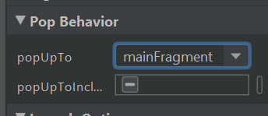
Lets Try It
Open your navigation graph.
Click the action arrow from the GameFragment to the MainFragment.
Set the popUpTo attribute to mainFragment.
Alternatively, if you finished your homework last week, you can use arrow from the ResultFragment to the main fragment.
Informatics Engineering | Universitas Surabaya

Slide 12
Bottom Bar With navigation component
Informatics Engineering | Universitas Surabaya

Slide 13
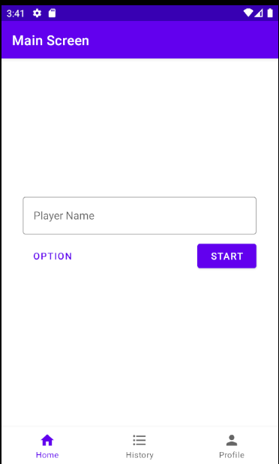
Bottom Bar Navigation
In the previous Native course, you needed at least three components: a ViewPager, Bottom Navigation Bar, and Kotlin code to manually handle the navigation.
Now, let's try to replicate this using the Jetpack Navigation library.
Informatics Engineering | Universitas Surabaya

Slide 14
Bottom Bar With Nav Component
First we need three icons for bottom bar navigation.
Right click on res > new > Vector assets, and then create three icons:
home
list
person
Informatics Engineering | Universitas Surabaya

Slide 15



Fragments
Each bottom bar icon will navigate to its respective fragments
= MainFragment
= HistoryFragment
= ProfileFragment
Informatics Engineering | Universitas Surabaya

Slide 16

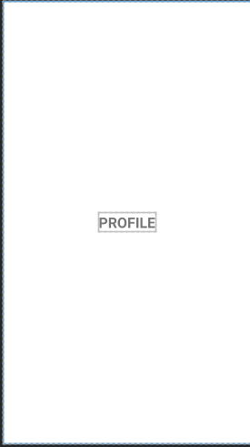
Create Fragments
Create two new fragments and name them HistoryFragment and ProfileFragment.
Follow the same steps as in Week 1 to clean up the code in the fragment classes (view binding implementation is not required).
For each fragment, set the layout to match the screenshot on the right.
Informatics Engineering | Universitas Surabaya

Slide 17
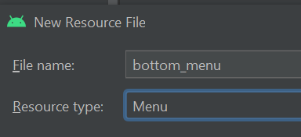
Create Bottom Menu Resource
Next step is creating bottom bar menu resource file
Right click on res > new > Android resource file
Fill in file name to “bottom_menu”
Choose resource type as “menu” (this will generate menu folder within res)
Press OK
Informatics Engineering | Universitas Surabaya

Slide 18
Create Bottom Menu Resource
Drag three Menu Items and set attributes as indicated here:
Home Icon
Id = itemHome
Icon = drawable home
showAsAction = always
Title = home
History Icon
Id = itemHistory
Icon = drawable list
showAsAction = always
Title = history
3. Profile Icon
Id = itemProfile
Icon = drawable person
showAsAction = always
Title = profile
Informatics Engineering | Universitas Surabaya

Slide 19
Add Bottom Navigation
Next step is adding bottom navigation to MainActivity layout
Open activity_main.xml
Drag and drop BottomNavigationView component
Change id to “bottomNav”
Set menu to “@menu/bottom_menu”
Set layout_width = match_constraint
Set layout_height = wrap_content
Constrained to very bottom of screen
Informatics Engineering | Universitas Surabaya

Slide 20
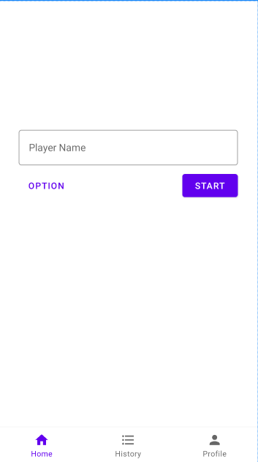
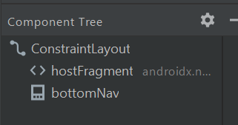
Add Bottom Navigation
Informatics Engineering | Universitas Surabaya

Slide 21
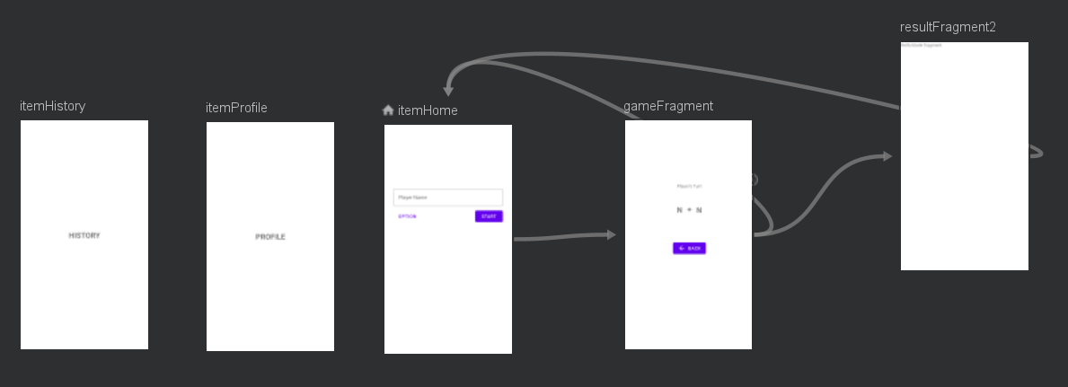
Update Navigation Graph
Next step, we should update navigation graph by adding new destinations (fragment profile and history). Open game navigations and add two destinations
Informatics Engineering | Universitas Surabaya

Slide 22
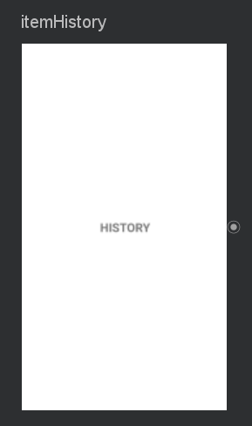
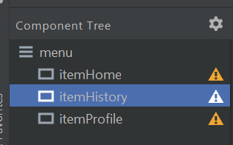
!! IMPORTANT !!
To create a connection between navigation controller with navigation bar you need to set same ID on both of Destinations Object and Menu Item ID
Informatics Engineering | Universitas Surabaya

Slide 23
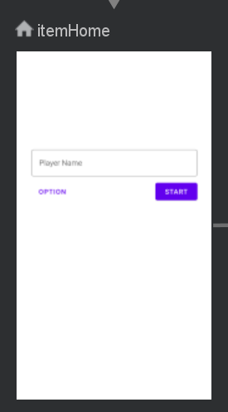
!! IMPORTANT !!
It means that for MainFragment destinations you should rename the id as “itemHome”
Informatics Engineering | Universitas Surabaya

Slide 24
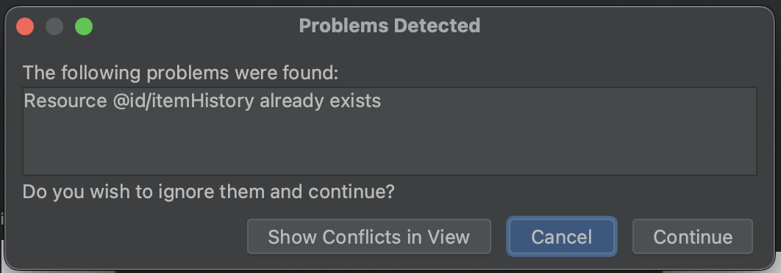
!! IMPORTANT !!
This dialog shows that the id already exists. Just press continue to ignore this warning.
Informatics Engineering | Universitas Surabaya

Slide 25
No Action/Arrow
For this case, its unnecessary to draws connection/arrow between those fragments. Bottom bar navigation allows user to jump in various fragment without specific flow order.
Informatics Engineering | Universitas Surabaya

Slide 26
Establish Connection
Final step is to establish connection between nav controller and the bottom bar. Remember: nav controller holds navigation host that relies on navigation graph.
Open main activity, add following codes inside onCreate method:
binding.bottomNav.setupWithNavController(navController)
Informatics Engineering | Universitas Surabaya

Slide 27
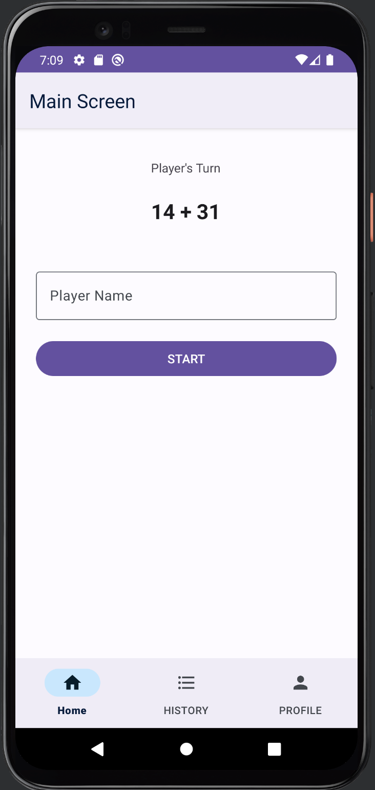
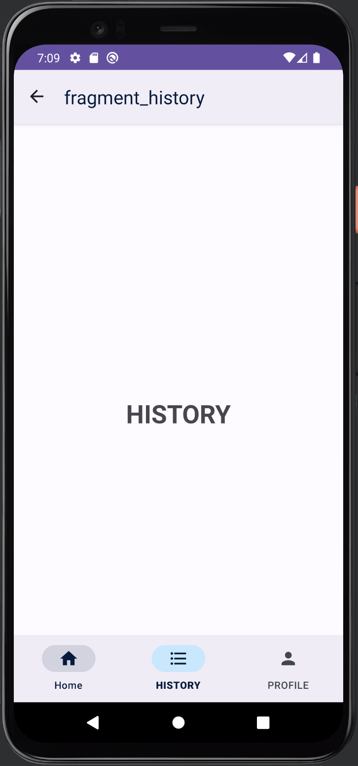
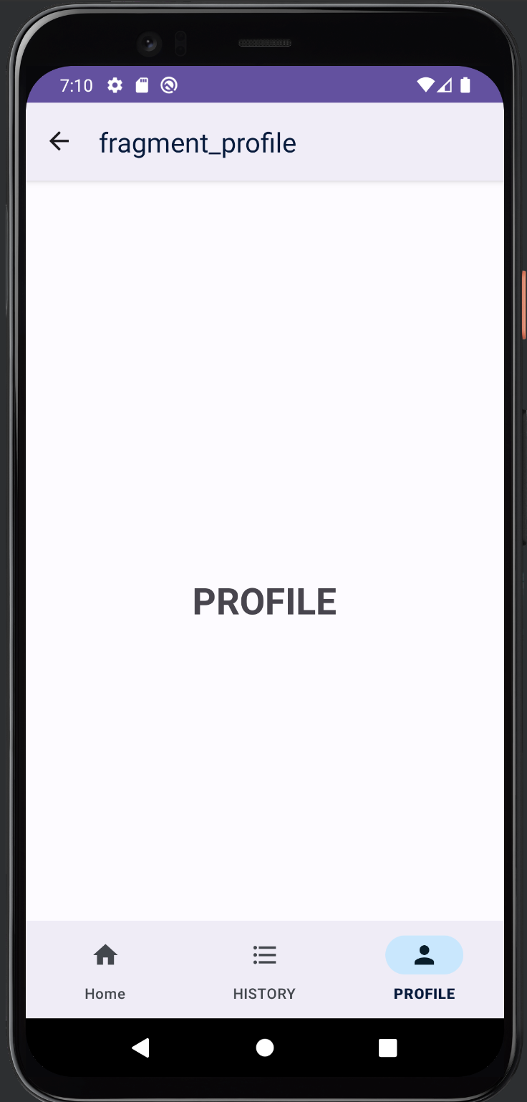
Results
Informatics Engineering | Universitas Surabaya

Slide 28
Dialog With navigation component
Informatics Engineering | Universitas Surabaya

Slide 29
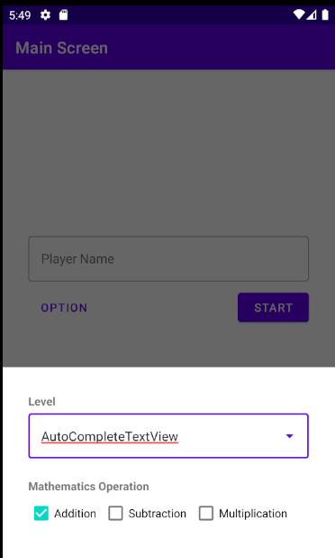
Bottom Sheet Dialog
In previous Native courses, you used AlertDialog builders or custom dialog fragments to display a dialog. This time, we will use a dialog fragment with navigation to create a bottom sheet dialog.
Informatics Engineering | Universitas Surabaya

Slide 30
Dialog Fragment
First step, of course we need dialog fragment. Create a new fragment and set name as OptionFragment
Extend the fragment class to
class OptionFragment : BottomSheetDialogFragment() {
BottomSheetDialogFragment just fundamentally acts as regular dialog, but will slide up from bottom screen (with animation)
Informatics Engineering | Universitas Surabaya

Slide 31
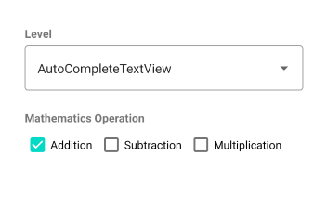
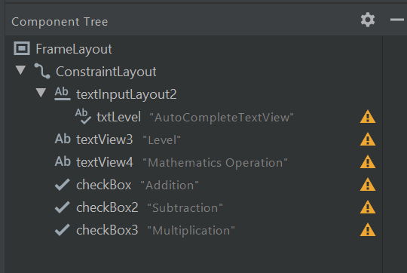
Dialog Fragment Layout Create layout based on reference below
Since the `TextInputLayout` mode is set to "dropdown," you need to replace the `TextView` with an `AutoCompleteTextView`.
First, remove the original `TextView` and then add the `AutoCompleteTextView` in its place. And set the layout height and width to “match_parent”
txtInputLayout endIconMode = dropdown_menu
style = @style/Widget.MaterialComponents.textinputLayout.OutlinedBox
Informatics Engineering | Universitas Surabaya

Slide 32
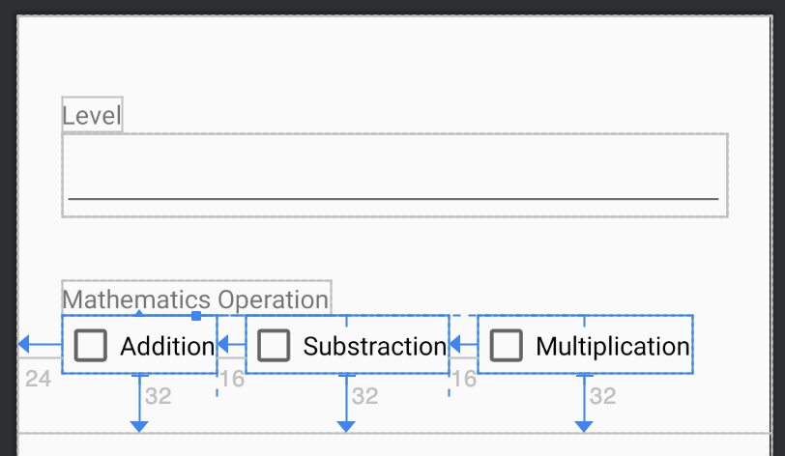
Dialog Fragment Layout
ConstraintLayout parent
Layout_width = match_parent
Layout_height = wrap_content
Set bottom constraint for the Three checkboxes
Informatics Engineering | Universitas Surabaya

Slide 33
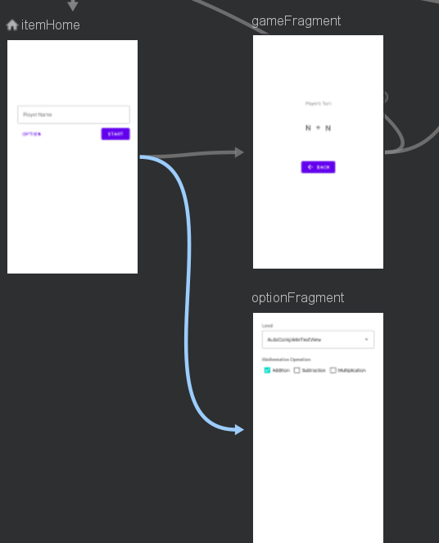
Update The Graph
Open navigation graph, add dialog optionFragment as new destination
Draw arrow/actions from itemHome (main Fragment) to optionFragment
As usual rename actions as “actionOptionFragment”
Don’t create opposite arrow from optionFragment, because dialog should close itself if user tap on outside of dialog body
Informatics Engineering | Universitas Surabaya

Slide 34
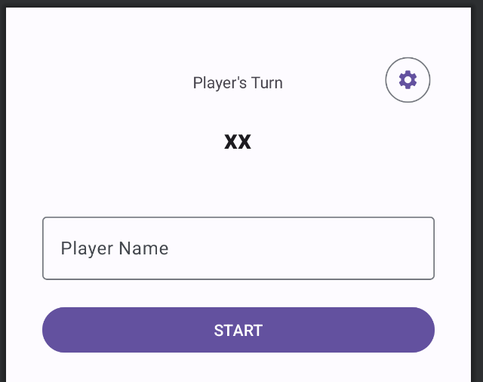
Add Options Button
To invoke the dialog, we need a button in main fragment layout.
Add the icon by create new vector asset. Find the “settings” icon.
Drag and drop the button and constrained on the upper right of the screen
Change the “style” properti to @style/Widget.Material3.Button.IconButton.Outlined
Set id to btnOption
Change the “icon” properti
Informatics Engineering | Universitas Surabaya

Slide 35
Trigger The Dialog
To trigger the dialog, it doesn't requires alert dialog. Use the same method like navigating to other screens
In MainFragment.kt (onViewCreated), add following codes
binding.btnOption.setOnClickListener {
val action = MainFragmentDirections.actionOptionFragment()
Navigation.findNavController(it).navigate(action)
}
Informatics Engineering | Universitas Surabaya

Slide 36
Results
Click option button
The dialog should appear from bottom screen
Click on outside of dialog body to close the dialog
Informatics Engineering | Universitas Surabaya

Slide 37
Trigger The Dialog
Back to the OptionFragment, create following static array:
private val LEVEL = arrayOf("Easy", "Medium", "Hard")
And initilaize the AutoCompleteTextView inside the onViewCreated
override fun onViewCreated(view: View, savedInstanceState: Bundle?)
{
super.onViewCreated(view, savedInstanceState)
val adapter:ArrayAdapter<String> = ArrayAdapter<String>(requireContext(),
android.R.layout.simple_dropdown_item_1line, LEVEL)
binding.txtLevel.setAdapter(adapter)
}
Informatics Engineering | Universitas Surabaya

Slide 38
Drawer With navigation component
Informatics Engineering | Universitas Surabaya

Slide 39
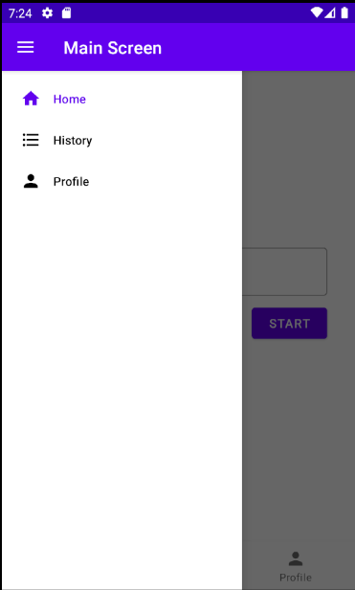
Nav Drawer
Last semester in the NMP course, you had to manually implement navigation for each menu item in the drawer. With the Jetpack Navigation library, this process can now be automated.
Informatics Engineering | Universitas Surabaya

Slide 40
Navigation Drawer
Navigation drawer can co-exist with bottom navigation
To create a navigation drawer, the first step is to wrap your layout under DrawerLayout component
This need to be done manually, in XML codes
Note: please refer to Native course for more information about drawer layout
Informatics Engineering | Universitas Surabaya

Slide 41

Navigation Drawer
Open activity_main.xml, click on button to switch view from design to XML codes. Write following codes at the top of the layout.
<?xml version="1.0" encoding="utf-8"?>
<androidx.drawerlayout.widget.DrawerLayout xmlns:android="http://schemas.android.com/apk/res/android"
xmlns:app="http://schemas.android.com/apk/res-auto"
xmlns:tools="http://schemas.android.com/tools"
android:id="@+id/drawerLayout"
android:layout_width="match_parent"
android:layout_height="match_parent"
android:fitsSystemWindows="true">
Cut paste these three xml codes from Constraint layout tags
This drawer layout id is “drawerLayout”
Informatics Engineering | Universitas Surabaya

Slide 42
Navigation Drawer
<androidx.drawerlayout.widget.DrawerLayout . . .>
<androidx.constraintlayout.widget.ConstraintLayout
android:layout_width="match_parent"
android:layout_height="match_parent"
tools:context=".MainActivity">
....
</androidx.constraintlayout.widget.ConstraintLayout>
</androidx.drawerlayout.widget.DrawerLayout>
Wrap constraint layout within drawer layout tags
Enclosed drawer layout tag
Informatics Engineering | Universitas Surabaya

Slide 43
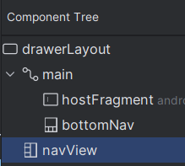
Nav Drawer
Switch back to design view, drag and drop a navigation view component, and arrange it like following screenshot.
Navigation View
Id = navView
layout_gravity =”start”
layout_width = wrap_content
layout_height = match_parent
Menu = @menu/bottom_menu
IMPORTANT! Navigation View must be placed on the bottom of the Constraint layout. It is Not under the Constraint layout
Informatics Engineering | Universitas Surabaya

Slide 44
Navigation View
Notice that navigation view is using the same menu resource files as bottom navigation bar.
It means that the drawer will render the same menu structure and item as the navigation bar. Therefore, no need to update navigation graph.
Of course you can create separate menu for the drawer
For simplicity purpose, we don't use a navigation header during the tutorial
Informatics Engineering | Universitas Surabaya

Slide 45
Establish Connection
Final step is to establish connection between drawer & navigation view to navigation controller
Open MainActivity.kt
Informatics Engineering | Universitas Surabaya

Slide 46
Establish Connection
Write following codes under onCreate:
super.onCreate(savedInstanceState)
binding = ActivityMainBinding.inflate(layoutInflater)
val view = binding.root
setContentView(view)
navController = (supportFragmentManager.findFragmentById(R.id.hostFragment) as NavHostFragment).navController
NavigationUI.setupActionBarWithNavController(this, navController, binding.drawerLayout)
NavigationUI.setupWithNavController(binding.navView, navController)
. . .
This refer to drawer layout component
Navigation view also need to be handled by NavController
Informatics Engineering | Universitas Surabaya

Slide 47
Establish Connection
Update onSupportNavigateUp method:
override fun onSupportNavigateUp(): Boolean {
return NavigationUI.navigateUp(navController, binding.drawerLayout) || super.onSupportNavigateUp()
}
This refer to drawer layout component
This code automatically detects if the user is on the top level of backstack: the drawer icon will show instead of the back button
Informatics Engineering | Universitas Surabaya

Slide 48
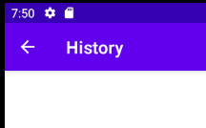
Results
Navigation Controller automatically handles item click navigation
If user is not in top level of backstack then back icon will displayed
Remember that you must use same id both for navigation graph destinations and menu item
Photo here
Informatics Engineering | Universitas Surabaya

Slide 49
Recap
popUpTo: remove (pop) fragments from the backstack until it reaches a specific destination fragment
popUpToInclusive: clears (pops) all fragments from the backstack up to and including the specified destination
NavigationGraph can handle interaction with BottomBarNavigation, Drawer, and Dialog
Connecting NavController with both bottom bar and drawer, enabling automatic handling of item clicks, backstack icons, and top-level destinations
Informatics Engineering | Universitas Surabaya

Slide 50
Thanks.
Informatics Engineering | Universitas Surabaya

